Slide 1

IoT Enabled Smart Laboratory
Group No. 06
Prathmesh Pande: 16104020
Ritesh Shetty: 16104048
Bhavana Kondurkar: 16104066
Project Guide: Prof. Vishal Badgujar.

Slide 2
Contents
Introduction
Objectives
Problem Definition
Proposed Technological Stack
Review Suggestions
Proposed System Architecture
Prototype Design Demonstration
Plan of Paper Publication

Slide 3
Introduction
In our Lab, there are multiple appliances like Lights, Fans, Air Conditioners, and Projectors.
The current, usual way to control the appliances in the lab is to manually toggle switches on the switch board of the particular Lab.
However, that in itself is a time consuming task as a person has to be available to do so.
Our proposed system is aimed at developing an automated solution where even if the end-user/admin is located remotely, the appliances can be turned on.

Slide 4
Objectives
To minimize, monetary costs, user discomfort, delays, utilization of resources.
To automatize the appliance dominant of Labs.
To reduce the power consumption by economical usage of the appliances.
To integrate laboratory timetable with the system.

Slide 5
Problem Definition
Our institute has an abundance of laboratories and therefore, more staff. Naturally most of the faculties have totally different operating patterns than others.
Every time if a lab session ends, usually the machines and appliances are left running.
Physically toggling the individual lights, fans and systems within the starting of a lab session adds to the wastage of your time of the session.
To combat this, we want to create a system for our college where the labs can be controlled remotely to save time, power consumption and energy in terms of manpower.

Slide 6
Proposed Technological Stack
Node-RED: For wiring along all the devices and services with the help of its browser-based editor. To create a GUI dashboard for managing and controlling the ecosystem.
MQTT (Message Queuing telemetry Transport): For communication protocol. Its features like small code footprint low power & bandwidth consumption, pub/sub pattern, makes it suitable for this use case.
Mosquitto: Eclipse Mosquitto is an open source (EPL/EDL licensed) message broker that implements the MQTT protocol.
Raspberry Pi: For its price to performance ratio and its versatility as an overall package.
SQLite: For backend data management.

Slide 7
Review Suggestions
We ensured cross platform compatibility with Android, Windows, iOS, Linux, since this will be a browser based web application so it can run on any browser.
We explored multiple applications to simulate automation, and found TinkerCAD, which at least allows us to test bare minimum automation.
Last time we have not confirmed our core technology stack as we were not sure. This time, the core technologies we will be using are confirmed.
Last time we only had done with the Sem VI report. In this semester, we have created paper for IEEE conference and submitted for publication. Waiting for a positive response.

Slide 8
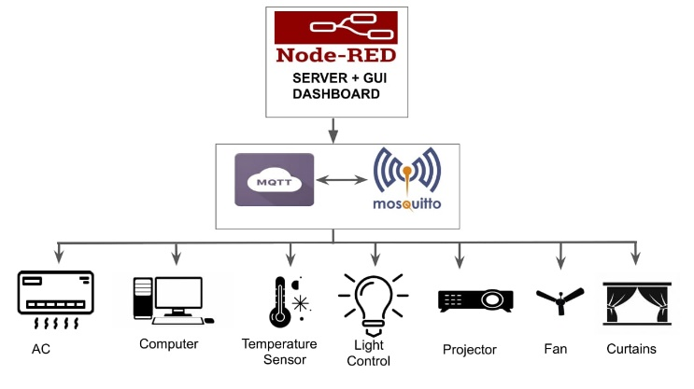
Proposed System Architecture
Figure 1: Proposed System Architecture

Slide 9
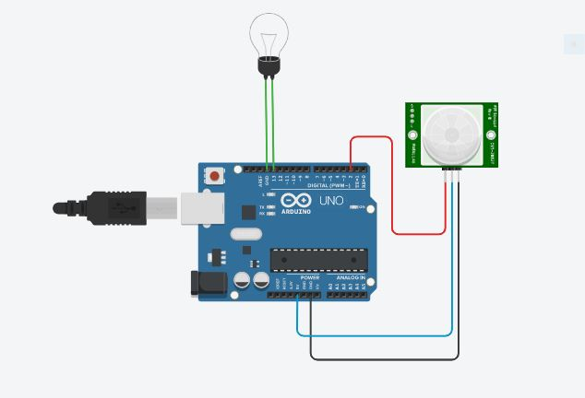
Prototype Design Simulation
Figure 2: Circuit diagram of Light control using Arduino and PIR sensor.

Slide 10
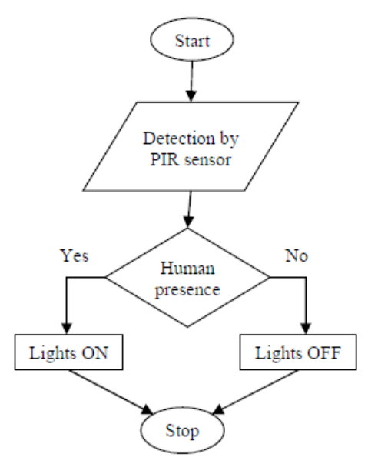
Figure 3: Flow of Working.

Slide 11
Working of prototype:
Initially, when there is no human movement, the PIR Sensor doesn’t detect any person and its OUT pin stays LOW.
As the person enters the room, the change in infrared radiation in the room is detected by the PIR Sensor.
As a result, the output of the PIR Sensor becomes HIGH and the light glows.
When the person leaves the room, after a delay, the sensor does not detect any human movement, causing the OUT pin to be LOW and turning the light off.

Slide 12
Plan of Paper Publication
Paper Title: IoT based Smart Laboratory
Publication: IEEE 6th International Conference for Convergence in Technology (I2CT), (http://ieeepune.i2ct.in)
Link to Paper: IoT Enabled Smart Laboratory.

Slide 13
Thank You!

